Slide 1
Arduino Morse Keyer
Presentation for KARG 2017
25/03/2017

Slide 2
Arduino(1)
Arduino is an open-source project that created microcontroller-based kits for building digital devices and interactive objects that can sense and control physical devices.
The project is based on microcontroller board designs, produced by several vendors, using various microcontrollers. These systems provide sets of digital and analog input/output(I/O) pins that can interface to various expansion boards (termed shields) and other circuits.
The boards feature serial communication interfaces, including Universal Serial Bus (USB) on some models, for loading programs from personal computers.

Slide 3
Name | Processor | Operating/Input Voltage | CPU Speed | Analog In/Out | Digital IO/PWM | EEPROM [kB] | SRAM [kB] | Flash [kB] | USB | UART
Due | ATSAM3X8E | 3.3 V / 7-12 V | 84 MHz | 12/2 | 54/12 | - | 96 | 512 | 2 Micro | 4
Esplora | ATmega32U4 | 5 V / 7-12 V | 16 MHz | - | - | 1 | 2.5 | 32 | Micro | -
Nano | ATmega168 ATmega328P | 5 V / 7-9 V | 16 MHz | 8/0 | 14/6 | 0.512 1 | 1 2 | 16 32 | Mini | 1
Mini | ATmega328P | 5 V / 7-9 V | 16 MHz | 8/0 | 14/6 | 1 | 2 | 32 | - | -
Yùn | ATmega32U4 AR9331 Linux | 5 V | 16 MHz 400MHz | 12/0 | 20/7 | 1 | 2.5 16MB | 32 64MB | Micro | 1
Leonardo | ATmega32U4 | 5 V / 7-12 V | 16 MHz | 12/0 | 20/7 | 1 | 2.5 | 32 | Micro | 1
Mega ADK | ATmega2560 | 5 V / 7-12 V | 16 MHz | 16/0 | 54/15 | 4 | 8 | 256 | Regular | 4
Retired Boards

Slide 4
Arduino(2)
For programming the microcontrollers, the Arduino project provides an Integrated Development Environment (IDE) based on a programming language named Processing, which also supports the C and C++ languages.
The Arduino Integrated Development Environment - or Arduino Software (IDE) - contains a text editor for writing code, a message area, a text console, a toolbar with buttons for common functions and a series of menus. It connects to the Arduino and Genuino hardware to upload programs and communicate with them.
The IDE software can be downloaded from:
http://www.Arduino.cc/

Slide 5
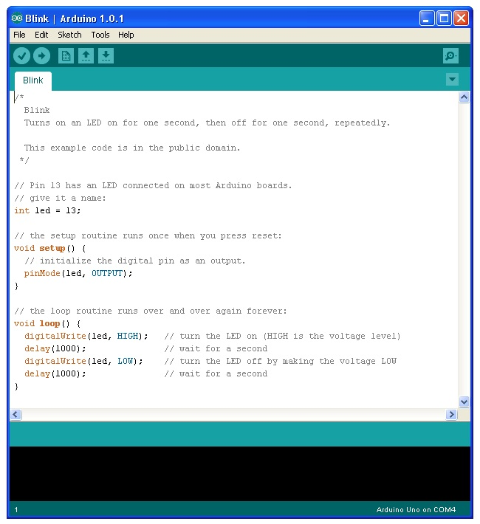
Example Sketch (Program) on IDE Screen

Slide 6
Nanokeyer
The Keyer was designed specifically for use with the K3NG Arduino keyer open-source firmware adding many features and flexibility.
The nanoKeyer is suitable as a standalone keyer or for keying the radio via the USB port from a connected computer and your favoured contest logging software. By means of the K3NG firmware it can be also used as a computerless keyboard keyer by attaching a PS2-Keyboard to it.
CW speed adjustable from 1 to 999 WPM
K1EL Winkeyer interface protocol emulation
Supported by major logging apps (e.g. N1MM, HRD, etc. in K1EL Winkeyer mode via USB port)
SO2R compatible through K1EL Winkeyer 2 protocol emulation
Command mode for using the paddle to change settings, program memories, etc.
PS2 Keyboard Interface for CW keyboard operation without a computer
PTT with configurable lead, tail, and hang times
Up to 12 memories with macro and serial number support
QRSS and HSCW
Iambic A and B, Ultimatic and Bug mode
Farnsworth Timing, Autospace and Wordspace Adjustment
Keying Compensation, Dah to Dit Ratio, Weighting adjustment
Non-volatile storage of most settings
The firmware is open source code provided by K3NG so you can customize it to fit your needs.
The keyer features one radio port with a optically isolated PTT keying line as well as the CW keying line.
The paddle is conneted with a standard 6.3mm Stereo Jack compatible with most modern radios.

Slide 7
Nanokeyer

Slide 8
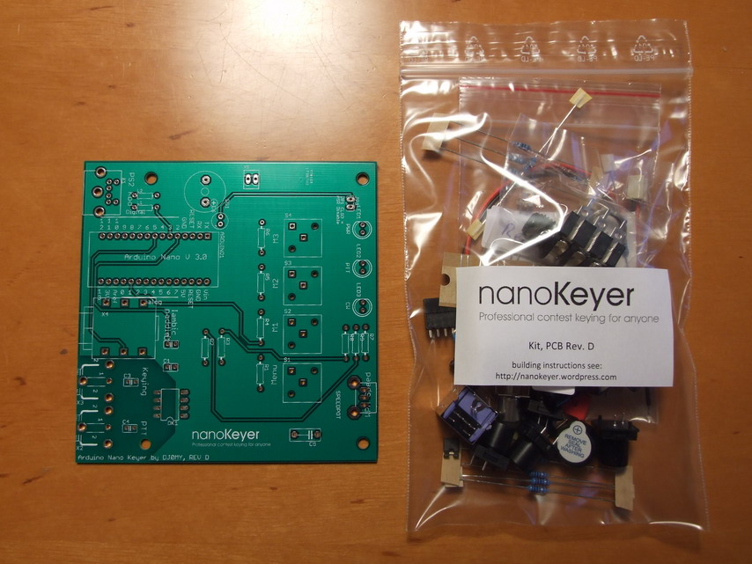

Slide 9
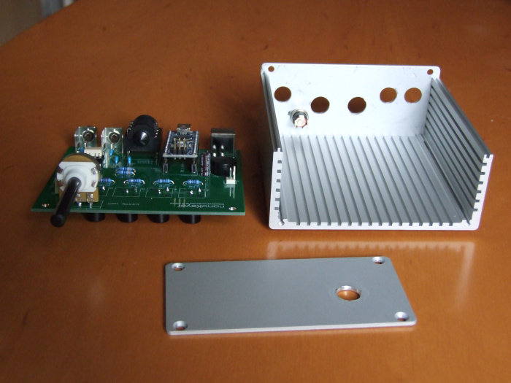
Nanokeyer

Slide 10
Nanokeyer
Nanokeyer Website:
https://nanokeyer.wordpress.com
Nanokeyer Kit available for €39.00 from:
Oscar.DJ0MY@GOOGLEMAIL.COM
Contains all parts except Arduino Nano

Slide 11
Current Boards
Name | Processor | Operating/ InputVoltage | CPU Speed | Analog In/Out | Digital IO/PWM | EEPROM [kB] | SRAM [kB] | Flash [kB] | USB | UART
101 | Intel® Curie | 3.3 V/ 7-12V | 32MHz | 6/0 | 14/4 | - | 24 | 196 | Regular | -
Gemma | ATtiny85 | 3.3 V / 4-16 V | 8 MHz | 1/0 | 3/2 | 0.5 | 0.5 | 8 | Micro | 0
LilyPad | ATmega168V ATmega328P | 2.7-5.5 V / 2.7-5.5 V | 8MHz | 6/0 | 14/6 | 0.512 | 1 | 16 | - | -
LilyPad USB | ATmega32U4 | 3.3 V / 3.8-5 V | 8 MHz | 4/0 | 9/4 | 1 | 2.5 | 32 | Micro | -
Mega 2560 | ATmega2560 | 5 V / 7-12 V | 16 MHz | 16/0 | 54/15 | 4 | 8 | 256 | Regular | 4
MKR1000 | SAMD21 Cortex-M0+ | 3.3 V/ 5V | 48MHz | 7/1 | 8/4 | - | 32 | 256 | Micro | 1
Pro | ATmega168 ATmega328P | 3.3 V / 3.35-12 V 5 V / 5-12 V | 8 MHz 16 MHz | 6/0 | 14/6 | 0.512 1 | 1 2 | 16 32 | - | 1
Pro Mini | ATmega328P | 3.3 V / 3.35-12 V 5 V / 5-12 V | 8 MHz 16 MHz | 6/0 | 14/6 | 1 | 1 | 32 | - | 1
Uno | ATmega328P | 5 V / 7-12 V | 16 MHz | 6/0 | 14/6 | 1 | 2 | 32 | Regular | 1
Zero | ATSAMD21G18 | 3.3 V / 7-12 V | 48 MHz | 6/1 | 14/10 | - | 32 | 256 | 2 Micro | 2

Slide 12
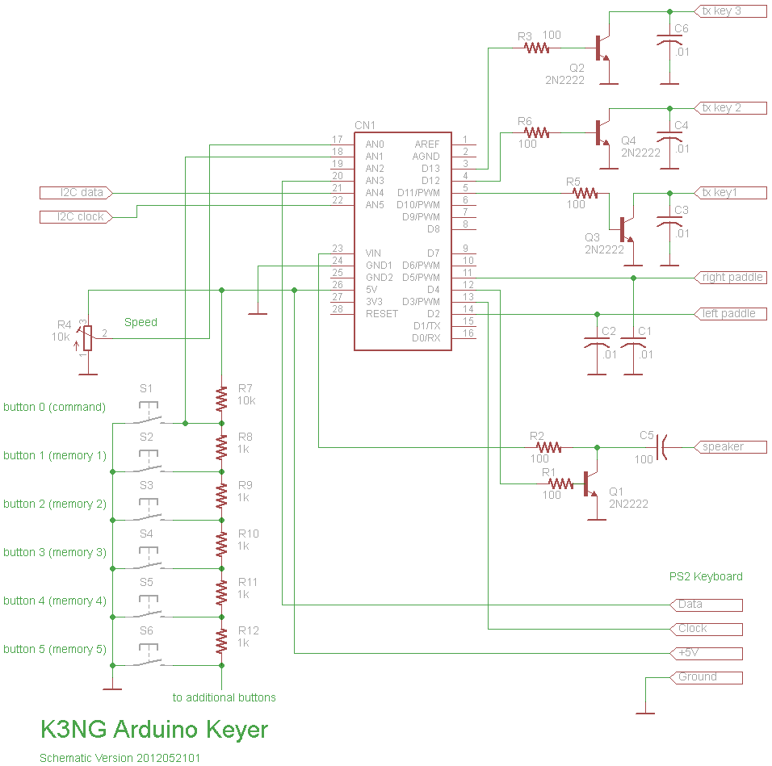

Slide 13
K3NG Keyer Features(1)
CW speed adjustable from 1 to 999 WPM
Up to six selectable transmitter keying lines
Programming and interfacing via USB port (“command line interface”)
USB or PS2 Keyboard Interface for CW keyboard operation without a computer
CW keyboard (via a terminal server program like Putty or the Arduino Serial program)
Logging and Contest Program Interfacing via K1EL Winkey 1.0 and 2.0 interface protocol emulation
Optional PTT outputs with configurable lead, tail, and hang times
Optional LCD Display – Classic 4 bit mode , Adafruit I2C RGB display or YourDuino I2C LCD Display
Up to 12 memories with macros
Serial numbers
Speed potentiometer/Rotary Encoder Speed Control/Speed also adjustable with commands
QRSS and HSCW
Beacon / Fox mode
Iambic A and B/Ultimatic mode/Bug mode/CMOS Super Keyer Iambic B Timing
Straight key support/Paddle reverse
Hellschreiber mode (keyboard sending, memory macro, beacon)
Adjustable frequency sidetone

Slide 14
K3NG Keyer Features(2)
Sidetone disable / sidetone high/low output for keying outboard audio oscillator
Command mode for using the paddle to change settings, program memories, etc.
Keying compensation
Dah to Dit Ratio adjustment
Weighting
Callsign Receive practice/Send practice
Memory stacking
“Dead Operator Watchdog”
Autospace/Wordspace Adjustment
Pre-configured and Custom Prosigns
Non-volatile storage of most settings
Modular code design allowing selection of features and easy code modification
Non-English Character Support
CW Receive Decoder
USB Mouse Support
Alphabet Sending Practice
QLF / “Messy” Straight Key Emulation

Slide 15
K3NG Features and Options
Starting with (stable release) Version 2.0, the configuration options and various other settings are broken out into separate files:
keyer_features_and_options.h : configure the features you want here
keyer_pin_settings.h : map the pins you’re using with your hardware
keyer_settings.h : various settings for features; you probably won’t need to touch this unless you’re a power user or want to tweak stuff
keyer_debug.h : turns on debugging code; you probably won’t ever have to touch this unless you’re deep in the code or someone on the Radio Artisan group asks you to enable debugging and post the debug logs for troubleshooting purposes
keyer.h : various declarations used in the k3ng_keyer.ino code
k3ng_keyer.ino : this is the main code; object declarations for some hardware devices are included in this file
keyer_hardware.h : This is for defining custom or preset configurations. More detail is below.
keyer_dependencies.h: Don’t touch this file.
ps2_keyboard_library

Slide 16
Memory use
Sketch uses 36,922 bytes (14%) of program storage space. Max is 253,952 bytes.
Global variables use 1,166 (14%) of dynamic memory leaving 7,026 bytes for local variables. Maximum is 8,192bytes.

Slide 17
PS2 Keyboard Functions(1)
F1 through F12 – play memories 1 through 12
Up Arrow – Increase CW Speed 1 WPM
Down Arrow – Decrease CW Speed 1 WPM
Page Up – Increase sidetone frequency
Page Down – Decrease sidetone frequency
Right Arrow – Dah to Dit Ratio increase
Left Arrow – Dah to Dit Ratio decrease
Home – reset Dah to Dit Ratio to default
Tab – pause sending
Delete – delete the last character in the buffer
Esc – stop sending and clear the buffer
Scroll Lock – Merge the next two characters to form a prosign
Shift – Scroll Lock – toggle PTT line
CTRL-A – Iambic A Mode
CTRL-B – Iambic B Mode
CTRL-D – Ultimatic Mode

Slide 18
PS2 Keyboard Functions(2)
CTRL-E – Set Serial Number
CTRL-G – Bug Mode
CTRL-H – Hellschreiber Mode (requires FEATURE_HELL)
CTRL-I – TX Line Disable/Enable
CTRL-M – Set Farnsworth Speed (requires FEATURE_FARNSWORTH)
CTRL-N – Paddle Reverse
CTRL-O – Sidetone On/Off
CTRL-T – Tune
CTRL-U – PTT Manual On/Off
CTRL-W – Set WPM
CTRL-Z – Autospace On/Off
SHIFT-F1, F2, F3… – Program memory 1, 2, 3…
ALT-F1, F2, F3… – Repeat memory 1, 2, 3…
CTRL-F1, F2, F3… – Switch to transmitter 1, 2, 3…

Slide 19
Arduino Sources
www.banggood.com/
Arduino Mega 2560 R3 $9.65
3.2 inch TFT LCD display $9.89
5 pcs Mega 2560 R3 Atmega 2560-16 AU control board with USB cable $47.99
Mega 2560 R3 board with USB cable + 3.2 inch TFT LCD display module $17.69
Nano Atmega 328P with USB cable $4.33
5 pcs Amega 328P Arduino compatible Nano V3. No cable $14.89
www.ebay.ie
Nano V3.0 AVR Atmega 328P-AU Portsmouth £5.99+£3.50
Mega 2560 R3 Atmega 2560-16AU CH340G Christchurch UK €11.20 + €2.75
Arduino Mega 2560 R3 + cable £9.95 + £5.48
https://www.modmypi.com
Genuino Mega 2560 £31.50
www.maplin.com
Arduino Mega 2560 R3 €44.45, cable €4.65
Arduino Nano 29.45, cable 1.75

Slide 20
Arduino I2C connection
Arduino
20 SDA 20
Arduino Keyer
Mega 2560
Arduino TFT LCD Display
Mega 2560
21 SCL 21
Gnd Gnd
5V O/P VIN
USB from/to PC
Master Writer Code
Slave Receiver Code/Event Function

Slide 21
References
Websites:
https://blog.radioartisan.com/Arduino-cw-keyer/
https://github.com/k3ng/k3ng-cw-keyer
http://nanokeyer.files.wordpress.com/2012/01/nanokeyer-firmware-upload-guide.pdf
http://groups.yahoo.com/group/radioartisan/
Documentation:
Arduino in a Nutshell Jan Borchers download as free pdf file from :
https:// hci.rwth-aachen.de/Arduino
Arduino Programming Notebook, Brian W. Evans. www.Arduino.cc
Manuals and curriculum provide cohesive coverage of Arduino in general, or of specific applications of Arduino in particular. www.Arduino.cc
Wikipedia.
Getting Started with Arduino, Massimo Banzi & Michael Shiloh
Junk Box Arduino, James R. Strickland.
Arduino Project Handbook, Mark Geddes.
Arduino User Guide, Robert Scott.

